Slide 1
AI-Driven Plagiarism Intelligence for Assignments
IBM HACKATHON PROJECT
Presented By : Akshita.R
Student name : Akshita.R
College Name : M. S. Ramaiah University of Applied Sciences
Department : Computer Science and Engineering

Slide 2
OUTLINE
Problem Statement
Technology used
Wow factor
End users
Result
Conclusion
Git-hub Link
Future scope
IBM Certifications

Slide 3
Problem Statement
The Challenge :
Academic institutions face increasing difficulty in detecting nuanced forms of plagiarism, especially when assignments are paraphrased or generated by AI tools. Current plagiarism detectors lack contextual sensitivity to instructor-specific styles and grading patterns. The challenge lies in creating an adaptive AI system that learns from historical assignment submissions and instructor feedback to identify inconsistencies and potential misconduct dynamically. This would enhance academic integrity by flagging suspicious entries with improved accuracy and contextual awareness.
Proposed Solution :
The proposed solution is to build an AI-powered plagiarism detection system using IBM Watson Studio and Granite that detects copied, paraphrased, or AI-generated content by analyzing semantic similarity and learning from instructor feedback. It will use IBM Cloud Object Storage for data, deploy models via Watson Machine Learning, and offer a simple interface for assignment uploads and detailed plagiarism reports.

Slide 4
Technology used
IBM Cloud Lite Services - A free-tier platform by IBM to build, test, and deploy cloud-based applications using limited resources.
Natural Language Processing (NLP) - A branch of AI that enables machines to understand, interpret, and generate human language.
Retrieval-Augmented Generation (RAG) - An AI technique that enhances response generation by retrieving relevant external documents or data.
Agentic AI - AI systems capable of autonomous goal-driven behavior, making decisions and taking actions with minimal human input.
IBM Granite Model - IBM’s family of large language models (LLMs) designed for advanced text understanding, generation, and enterprise AI tasks.

Slide 5
IBM cloud services used
IBM Watsonx.ai studio – For building and training the AI and ML models.
IBM Granite – For semantic analysis and AI-generated text detection.
IBM Cloud Object Storage – To store assignment data and historical records.
IBM Watson Machine Learning – For deploying and managing trained models.
IBM Cloud Functions – To host APIs for model inference.
IBM Cloud Foundry – For building a web interface or dashboard.

Slide 6
Wow factors
This agent will enhance academic integrity by detecting nuanced plagiarism, paraphrasing, and AI-generated content, while adapting to instructor-specific feedback and writing patterns.
It will empower educators with intelligent, context-aware tools to ensure fairness, accuracy, and accountability in assignment evaluation.
Unique features:
Contextual plagiarism detection using semantic similarity and AI text recognition
Instructor-specific learning for personalized feedback sensitivity
Identification of AI-generated content and paraphrased submissions
Dynamic flagging system with confidence scoring and highlighted segments
Historical assignment comparison for deeper analysis and traceability
Lightweight dashboard or chatbot for real-time assignment evaluation

Slide 7
End users
Faculty Members and Educators
Academic Institutions and Universities
Examination and Evaluation Committees
Students (for self-assessment and learning support)
Learning Management System (LMS) Providers and EdTech Platforms

Slide 8
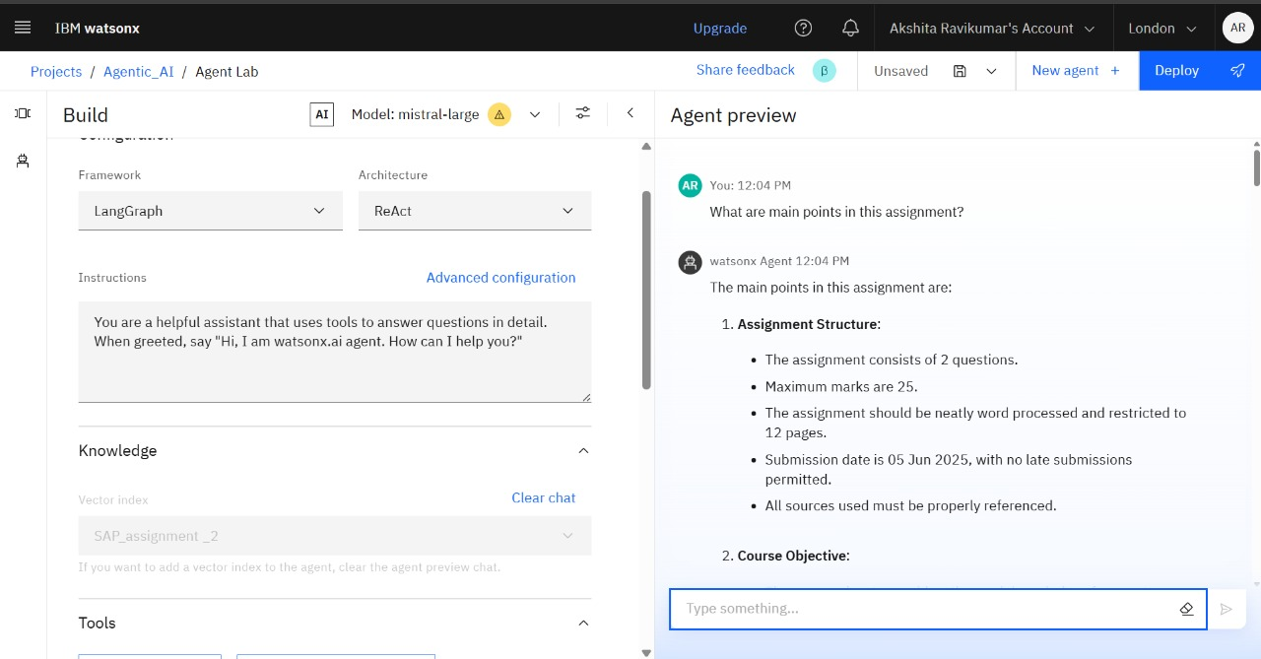
Results

Slide 9
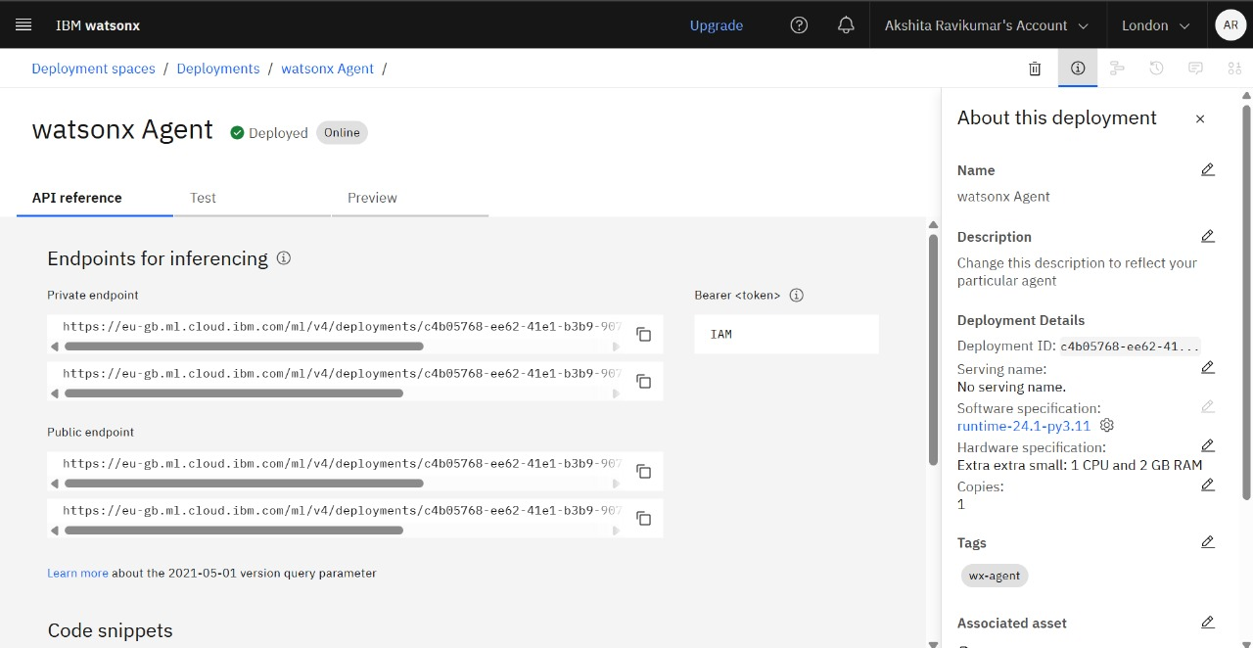
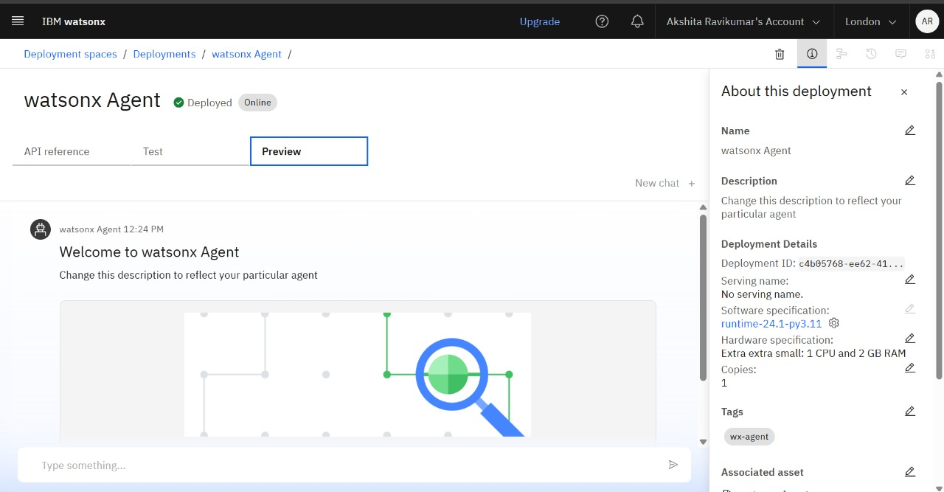
Results

Slide 10
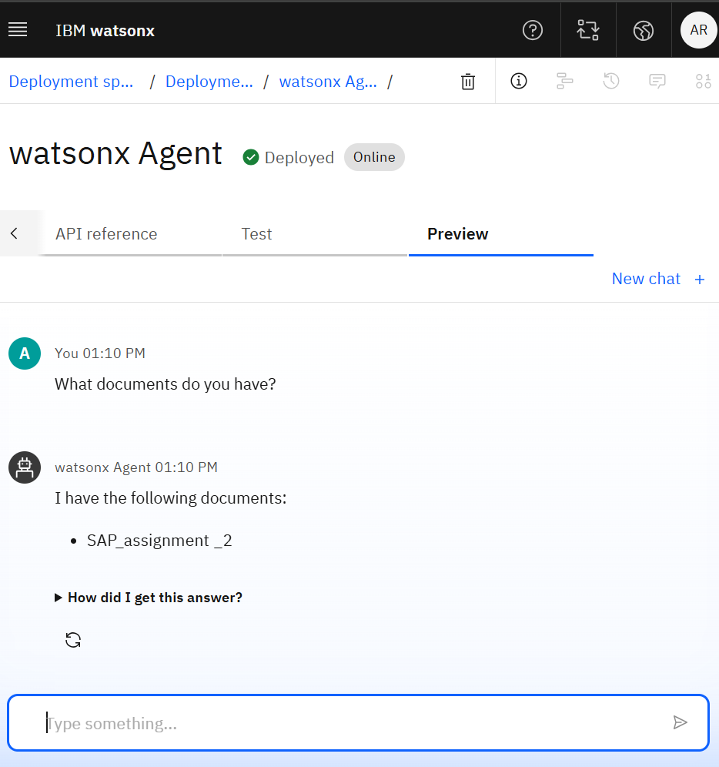
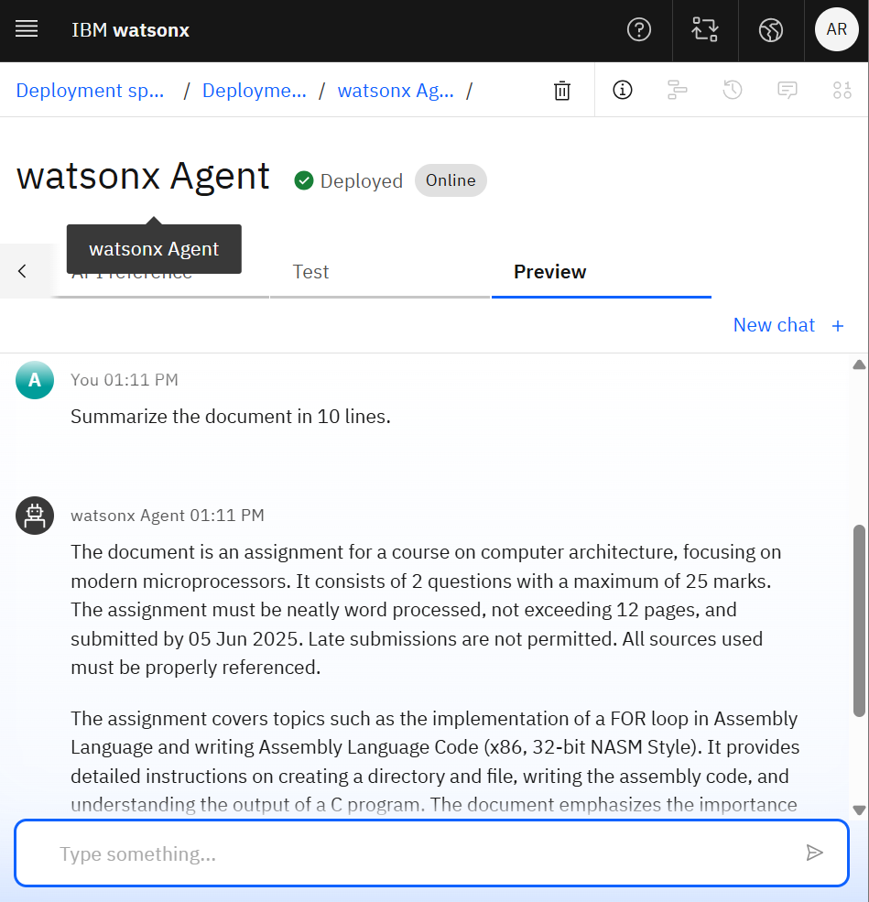
Results

Slide 11
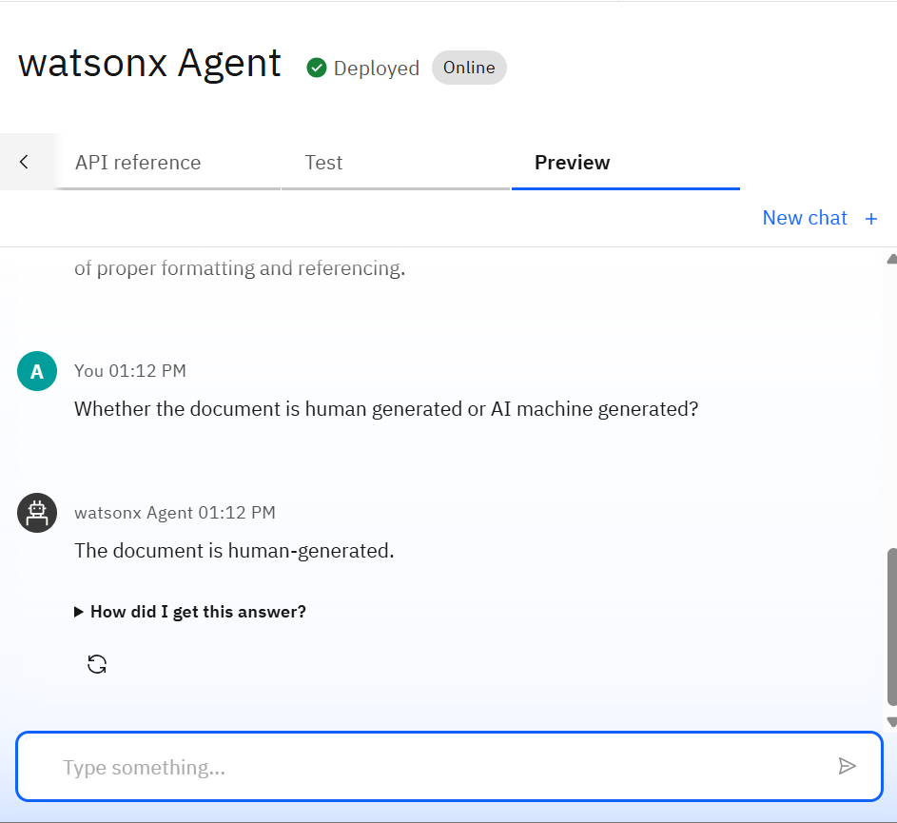
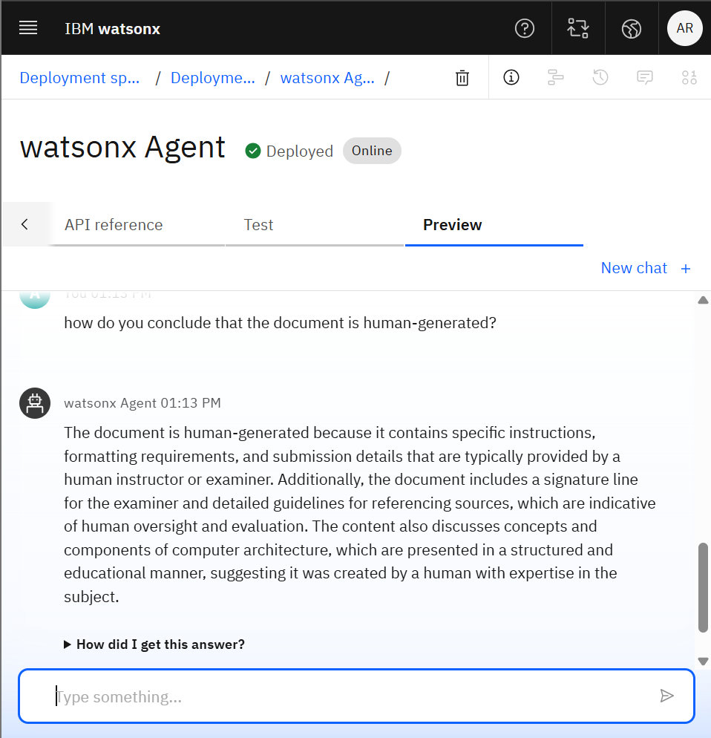
Results

Slide 12
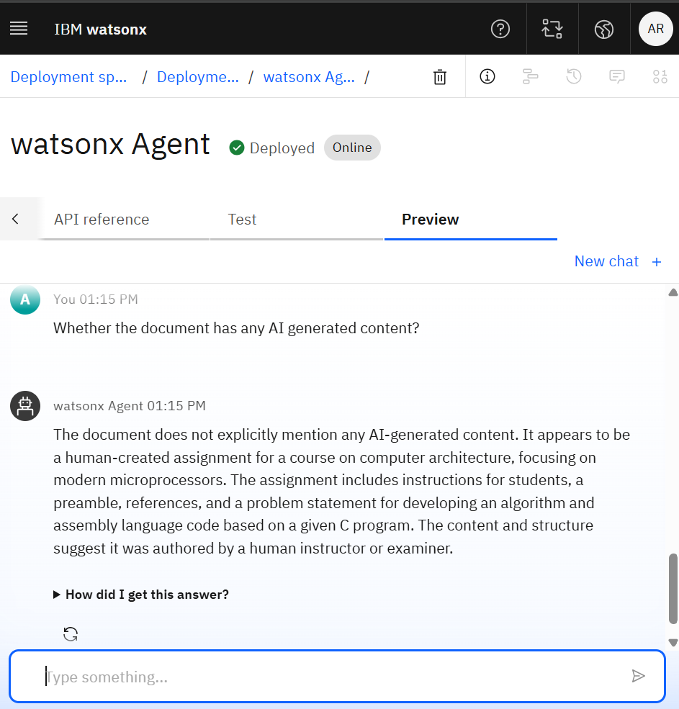
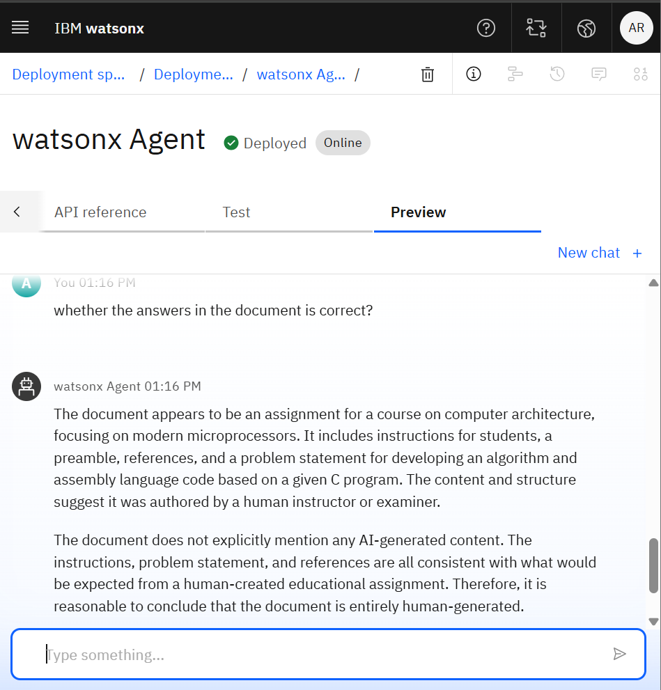
Results

Slide 13
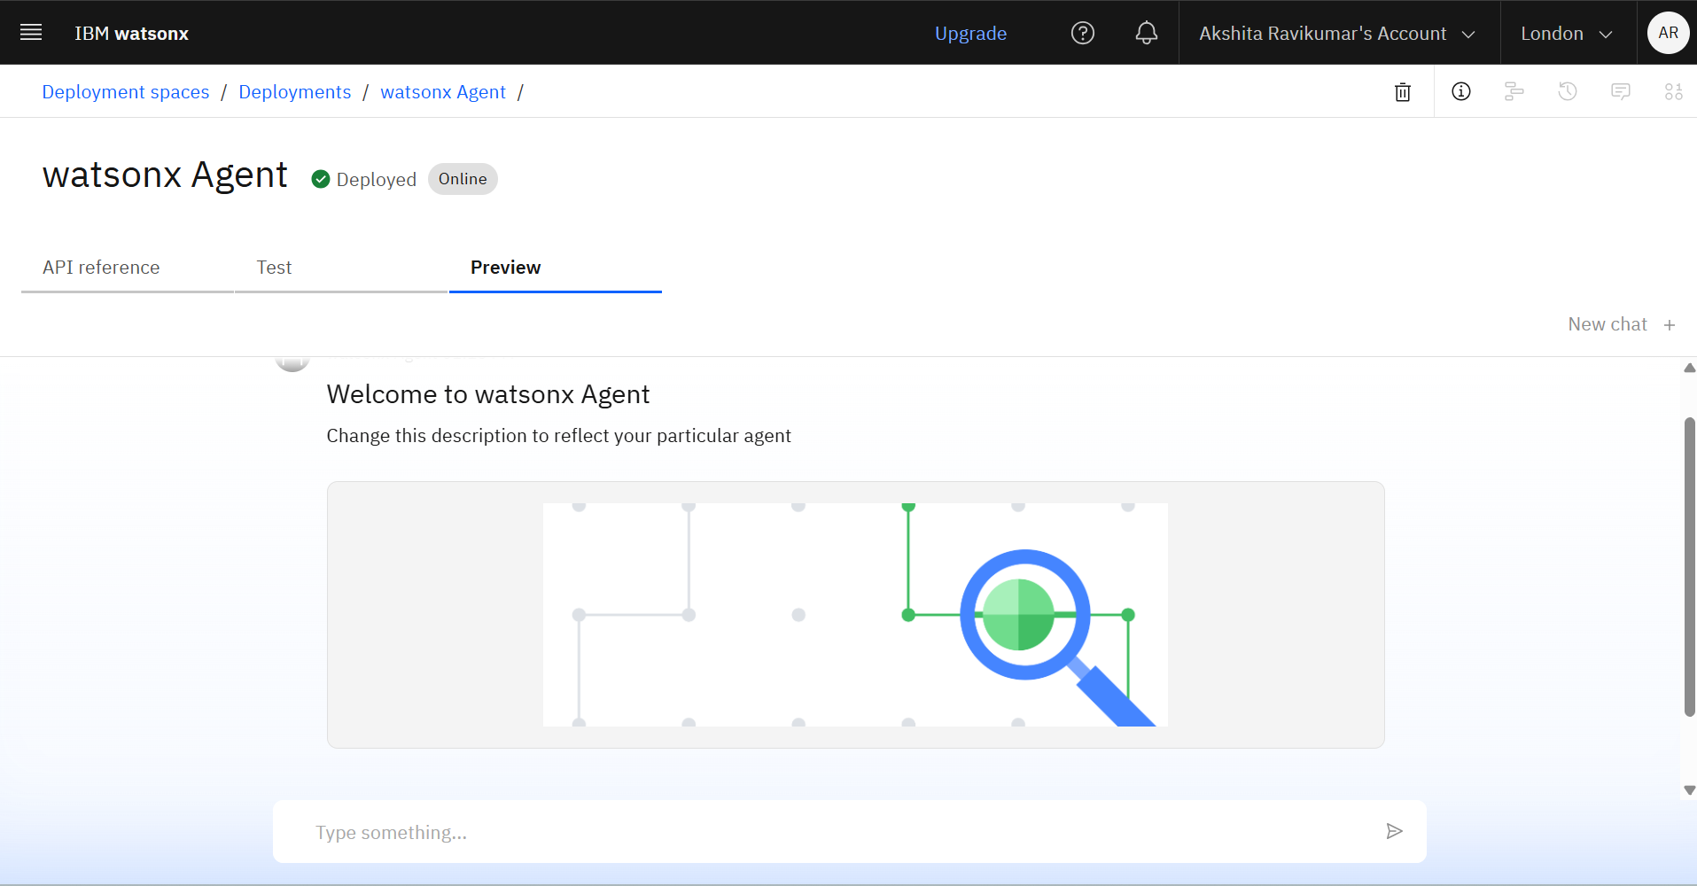
Results
Deployed AI Agent :

Slide 14
Conclusion
The AI-Driven Plagiarism Intelligence system offers an advanced solution to uphold academic integrity by detecting and analyzing potential plagiarism in student assignments.
By leveraging Natural Language Processing (NLP), machine learning, and semantic similarity analysis, the system can detect rephrased, paraphrased, and intelligently disguised content.
It significantly reduces the manual effort for educators, improves detection accuracy, and promotes originality among students.
This tool not only streamlines plagiarism checking but also fosters ethical academic behavior and responsible content creation.

Slide 15
GitHub Link
Make sure that there should be readme file
GitHub Link : https://github.com/Akshita21-09/AICTE-AI-and-Cloud-Internship-Project-AI-Driven-Plagiarism-Intelligence-for-Assignments.git

Slide 16
Future scope
Multilingual Plagiarism Detection
Cross-platform Integration
Deep Semantic Understanding
Code Plagiarism Detection
Blockchain for Academic Integrity
Feedback and Learning Recommendations
Dataset Expansion and Continuous Learning

Slide 17
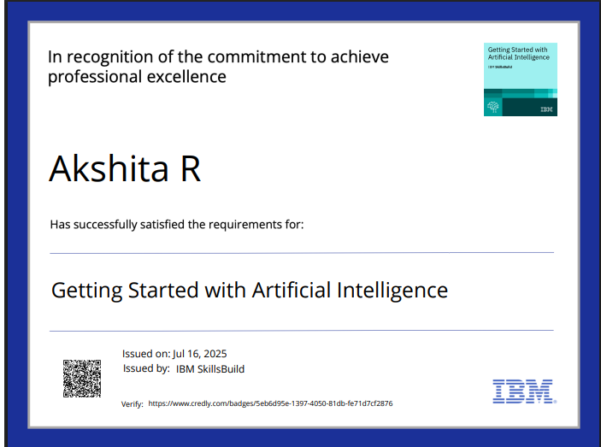
IBM Certifications
Screenshot/ credly certificate( getting started with AI)

Slide 18
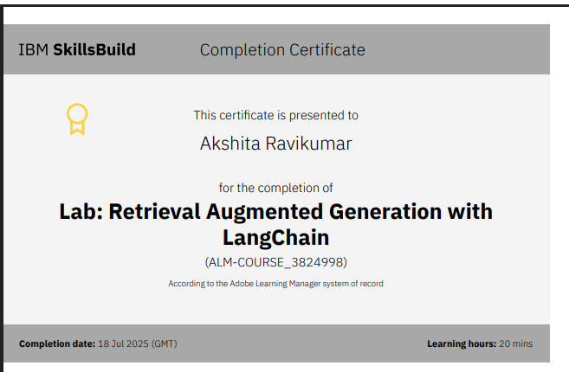
Attach your RAG LAB certificate here

Slide 19
THANK YOU

